Slide 1
Be rational
Get real
i
π
Practice Exam #2

Slide 2
Practice Exam #2
(DFT/FFT Theme)
Challenge 12
Practice Exam #2
Project 2 due.
Exam #2 – On-Camus Wednesday
- Off-Campus by Monday
Basis = 100
75 minutes
Exam #2 Review

Slide 3
Challenge 12
You are to Fourier transform data records of length 2000 samples. The data records can be lengthen using zero padding (i.e., adding zeros to the end of a data record).
For CT FFTs, pad the input record out to its minimum radix-2 length, How many levels are found in a minimum length radix-2 CT FFT?
N_{min}=2048=2¹¹,
Pad the 2000 sample record using 48 zeros,
Result: 11 level, 1024 2-point FFTs per level
Exam #2 Review

Slide 4
For a GT FFT, pad the input record out to its minimum Good Thomas length, How many levels are found in a minimum length Good-Thomas FFT?
N_{min}=2 × 7 × 11 × 13 = 2002 (manual)
Pad using 2 zeros,
4 levels.
Level 1 @ 1001 2 pt,
Level 2 @ 286 7 pt,
Level 3 @ 182 11 pt,
Level 4 @ 154 13 pt,

Slide 5
You decide to simplify your life by replacing the 2048-point CT FFT with a 16-point FFT. You determine that the original signal is real warranting the use of an 8-point real FFT. Two real N=8-point records x₁[k] and x₂[k] are used to form the 8-sample complex data record x[k]= x₁[k]+jx₂[k]. You record the FFT(x[k])=X[n] to be:
FFT(x[k])=X[n]=[1+j1, 1+j1, 1+j1, 1+j1, 1+j1, 1+j1, 1+j1]
What is FFT(x₁[k])=X₁[n] and FFT(x₂[k])=X₂[n]?
The real FFT production rules are (Lesson 12):
X₁[n] = (X[n]+X*[-nmod(N)])/2
X₂[n] = (X[n]-X*[-nmod(N)])/j2
Exam #2 Review

Slide 6
The real FFT production rules are:
X₁[n] = (X[n]+X*[-nmod(N)])/2
X₂[n] = (X[n]-X*[-nmod(N)])/j2
The sequence n=0,1,2,3,4,5,6,7 is mapped to:
-0mod(8)=0, -1mod(8)=7, -2mod(8)=6, … , -6mod(8)=2, -7mod(8)=1
X[n] = [1+j1, 1+j1, 1+j1, 1+j1, 1+j1, 1+j1, 1+j1]
X*[-nmod(8)] = [ 1-j1, 1-j1, 1-j1, 1-j1, 1-j1, 1-j1, 1-j1]
∑# /2 = [ 1, 1, 1, 1, 1, 1, 1]
X₁[n] = [ 1, 1, 1, 1, 1, 1, 1]
Exam #2 Review

Slide 7
From the real FFT production rules are:
X₁[n] = (X[n]+X*[-nmod(N)])/2
X₂[n] = (X[n]-X*[-nmod(N)])/j2
The sequence n=0,1,2,3,4,5,6,7 is mapped to:
-0mod(8)=0, -1mod(8)=7, -2mod(8)=6, … , -6mod(8)=2, -7mod(8)=1
X[n] = [1+j1, 1+j1, 1+j1, 1+j1, 1+j1, 1+j1, 1+j1]
-X*[-nmod(8)] = [-1+j1,-1+j1,-1+j1,-1+j1,-1+j1,-1+j1,-1+j1]
∑# / 2j = [ 1, 1, 1, 1, 1, 1, 1]
X₂[n] = [ 1, 1, 1, 1, 1, 1, 1]
Exam #2 Review

Slide 8
1-DFT
a) An N-point DFT with sample rate f_{s}=330Hz is to be used to identify a 60 Hz signal without leakage. What is the minimum value of N that meets the leakage requirement?
60=kΔf=kf_{s}/N=k330/N for k a harmonic index, N and k integers.
Noting that k/N=60/330 = 2/11 (irreducible), it follows that k=2, N=11.
Check (Δf=330/11=30)
(2Δf=60) - 2nd harnonic
Exam #2 Review

Slide 9
b) Suppose an N=100 point FFT is fabricated using a Cooley-Tukey ordering algorithm. What size “short” DFTs would be required to construct the 100-point C-T FFT?
100=4*25=2²5² =(2)(2)(5)(5) Short DFT lengths of 2 and 5.
Exam #2 Review

Slide 10
c) How many C-T FFT levels are there?
100 = (2)(2)(5)(5) - 4 levels
Exam #2 Review

Slide 11
d) How many repetitions of each small DFT are performed at each level? (no particular order)
(2)(2)(5)=20-5 point DFTs
(2)(2)(5)= 20-5 point DFTs
(2)(5)(5)= 50-2 point DFTs
(2)(5)(5)= 50-2 point DFTs
Order unimportant
Exam #2 Review

Slide 12
e) A CT FFT is to be designed having a length of at least 300 samples. What is the smallest radix-7 FFT length (i.e., N) solution?
The minimum length radix-7 (prime) transform is N=7³=345 for a 3 level transform (manual calculation). Each level consists of 49 7-point DFTs.
Exam #2 Review

Slide 13
f) What is the complex MAC count for a 7-point DFT?
How do you determine the MAC count?
We note that 7 is prime and cannot be further reduced. So a 7-point DFT serves as the small FFT in a radix-7 solution.
Exam #2 Review

Slide 14
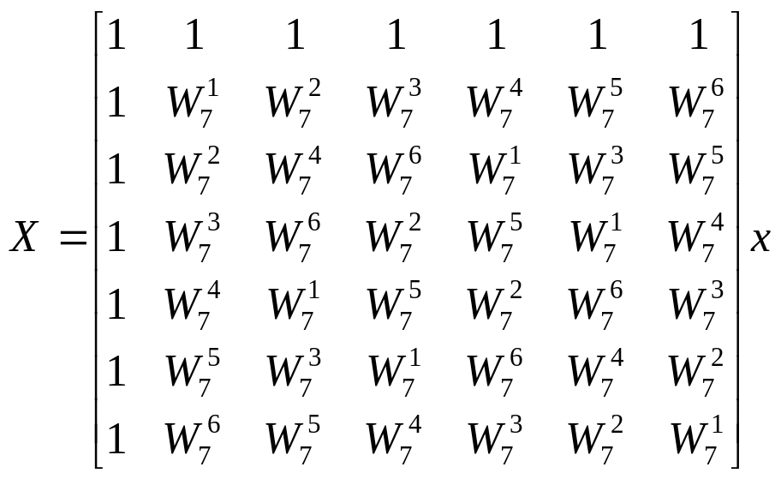
Each 7-point DFT would require 7²=49 complex multiplies. Also accept 6²=36.
Sidebar
For the entire FFT, using 49 multiplies per 7-point FFT, a total of:
3 (levels) * 49 (7-pt DFT/level) * 36 (complex multiplies per 7-pt. FFT) = 5292 complex multiplies.
Additional multiplies maybe required for twiddle factor (butterfly) correction.
Exam #2 Review

Slide 15
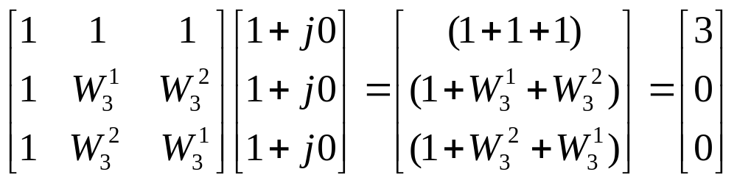
2-DFT
a) What is the 3-point DFT of the 3-sample complex signal x₁[k]={1+j0, 1+j0, 1+j0}?
Exam #2 Review

Slide 16
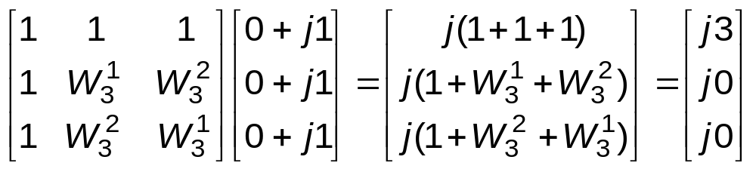
b) What is the 3-point DFT of the 3-sample complex signal x₂[k]={0+j1, 0+j1, 0+j1}?
Exam #2 Review

Slide 17
c) Suppose a new signal is synthesized to have the form x₃[k]= x₁[k]+ x₂[k]. What is the DFT of x₃[k]?
You could re-computed using the matrix method or realize that the DFT is a linear operator resulting in X₃[n]= [3,0,0] + [j3, j0, j0] = [(3+j3), 0, 0].
Exam #2 Review

Slide 18
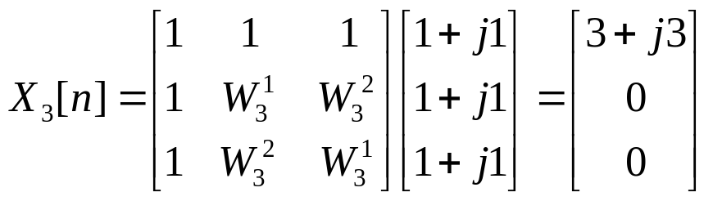
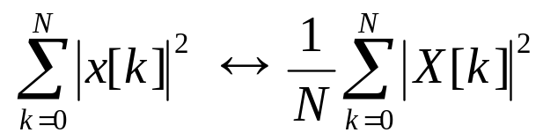
(d) Suppose the DFT of x₃[k] = x₁[k]+ x₂[k] = {1+j1,1+j1,1+j1} is X₃[n] = {3+j3,0,0}. What is the average signal power?
The signal of interest is x₃[k].
Use Parseval’s theorem to compute either time or frequency domain terms of the form:
Exam #2 Review

Slide 19
Time domain: E_{t}= |x₃[0]|²+|x₃[1]|²+|x₃[2]|² = |√2|²+|√2|²+|√2|² = 6
Frequency domain: E_{f}= (1/3)(|X₃[0]|²+|X₃[1]|²+ |X₃[2]|² ) = 6
These are, however, not power measures. They are in fact energy terms. The average power values are:
P_{t} = R_{t}/3 = 2
P_{f} = R_{t}/3 = 2
Exam #2 Review

Slide 20
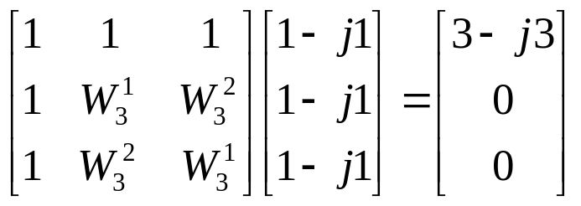
(e) Use the complex conjugate property of the DFT to compute the DFT of x₃*[k] where * denotes complex conjugation).
Complex conjugation property: x₃*[k] ↔ X₃*[-n mod(N)]
Given: x₃[k] ↔ X₃ [n]=[3+j3,0,0]
Then: x₃*[k] ↔ X₃*[-n mod(N)]={ X*[0], X*[2], X*[1] } = [3-j3,0,0]
Check:
Exam #2 Review

Slide 21
3-DFT
Suppose you decide to use your 3-point small DFT/FFT to construct a N=9-point Cooley-Tukey FFT. The 2-level radix-3 Cooley-Tukey FFT is shown below.
W₉⁰
a’
a=x[0] b=x[3]
c=x[6]
Block decomposition
a
b
c
3-pt FFT
W₉⁰
3-pt FFT
A
B
C
b’
W₉⁰
c’
k₁=0
n₂=0
W₉⁰
D
E
F
d
e
f
3-pt FFT
W₉¹
3-pt FFT
W₉²
k₁=1
n₂=1
W₉⁰
g
h
i
3-pt FFT
W₉²
G
H
I
3-pt FFT
W₉⁴
k₂=2
n₂=2
W₉^{k1n2}
Exam #2 Review

Slide 22
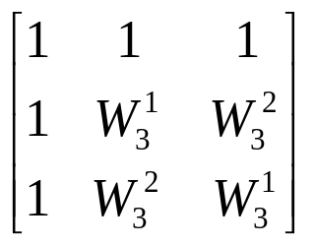
a. Assume x[0]=x[3]=x[6]=1, x[1]=x[2]=x[4]=x[5]=x[7]=x[8]=0. What is the output value of C?
Need to compute a’, b’, and c’, and perform a 3-point DFT using the matrix is shown:
W₉⁰
a’
1
1
1
3-pt FFT
W₉⁰
b’
3-pt FFT
A
B
C
W₉⁰
c’
k₁=0
n₂=0
0
0
0
W₉⁰
D
E
F
3-pt FFT
W₉¹
3-pt FFT
W₉²
k₁=1
n₂=1
W₉⁰
0
0
0
3-pt FFT
W₉²
3-pt FFT
G
H
I
W₉⁴
k₂=2
W₉^{k1n2}
n₂=2
Exam #2 Review

Slide 23
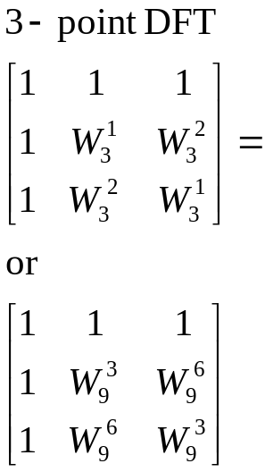
a’= (W₉⁰)(a+b+c) = (1)(3)=3
b’= (W₉⁰)(d+e+f) = (1)(0)=0
c’= (W₉⁰)(g+h+i) = (1)(0)=0
For N=9.
C=a’+(W₉⁶)b’+(W₉³)c’=3
W₉⁰
a’=3
b’ 0
c’=0
1
1
1
3-pt FFT
W₉⁰
3-pt FFT
A
B
C
W₉⁰
k₁=0
n₂=0
W₉⁰
D
E
F
0
0
0
3-pt FFT
W₉¹
3-pt FFT
W₉²
k₁=1
n₂=1
W₉⁰
0
0
0
3-pt FFT
W₉²
3-pt FFT
G
H
I
W₉⁴
k₂=2
W₉^{k1n2}
n₂=2
Exam #2 Review

Slide 24
4-DFT
You plan to use a software-enabled N-point FFT to equip your laptop for process audio recordings. The input data is sampled at a 8k Sa/s rate. The required frequency resolution is 20 Hz/harmonic.
a. What must the minimum FFT length, in samples, to meet this criterion?
Δf = f_{s}/N = 8000/N = 20 Hz per harmonic, therefore N=400.
Exam #2 Review

Slide 25
4-FT
b. You decide to use radix-3 FFTs to construct an N-sample Cooley-Tukey FFT where N=3^{n} ≥ 400, n an integer. What is the smallest radix-3 FFT length in samples? How many levels are there to the FFT? How many 3-point DFTs are performed at each level? How many 3-point DFTs are perform in total?
log₃(400)= 5.45367, therefore n=6 and N=3⁶=729.
There are 6 levels where each level consists of 3⁵=243 3-point DFTs.
For 6-levels, there are 1458 3-point FFTs performed.
Possible Butterfly corrections occur between levels were not counted.
Exam #2 Review

Slide 26
c. You find out that you have perfect pitch and can hold a note at f=1.01 kHz indefinitely. You sample the signal a f_{s}= 8kHz rate. What is the minimum time-series length N that will result in a leakage-free spectrum.
We need 1010=kΔf=k8000/N where k and N are integers. Then N/k = (8000/1010)= (800/101) which is irreducible. N=800, k=101 (i.e., Δf=8k/800=10 Hz/harmonic, k(Δf)=1010).
Exam #2 Review

Slide 27
d. You decide to impress everyone by considering the possibility of using a N=27 sample Good Thomas FFT. Does one exist and if so, how many levels does it have?
N=27=3*9=3*3*3, therefore a multi-stage Good-Thomas FFT does not exist.
However, a single stage 27-point Good Thomas FFT does.
Exam #2 Review

Slide 28
Questions?
DFT parameters
DFT properties
Cooley-Tukey FFT
Good-Thomas FFT
Real FFTs
No windows
No heavy number theory involving CRT, GF(p), RNS, …, prime factor FFT
Exam #2 Review

